Slide 1
Convolutional Neural Networks for Predicting Daily Orographic Precipitation Gradients for Downscaling
CIROH Developers Conference
Hydrological Applications of Machine Learning Workshops
Savanna Wolvin
05.30.24

Slide 2
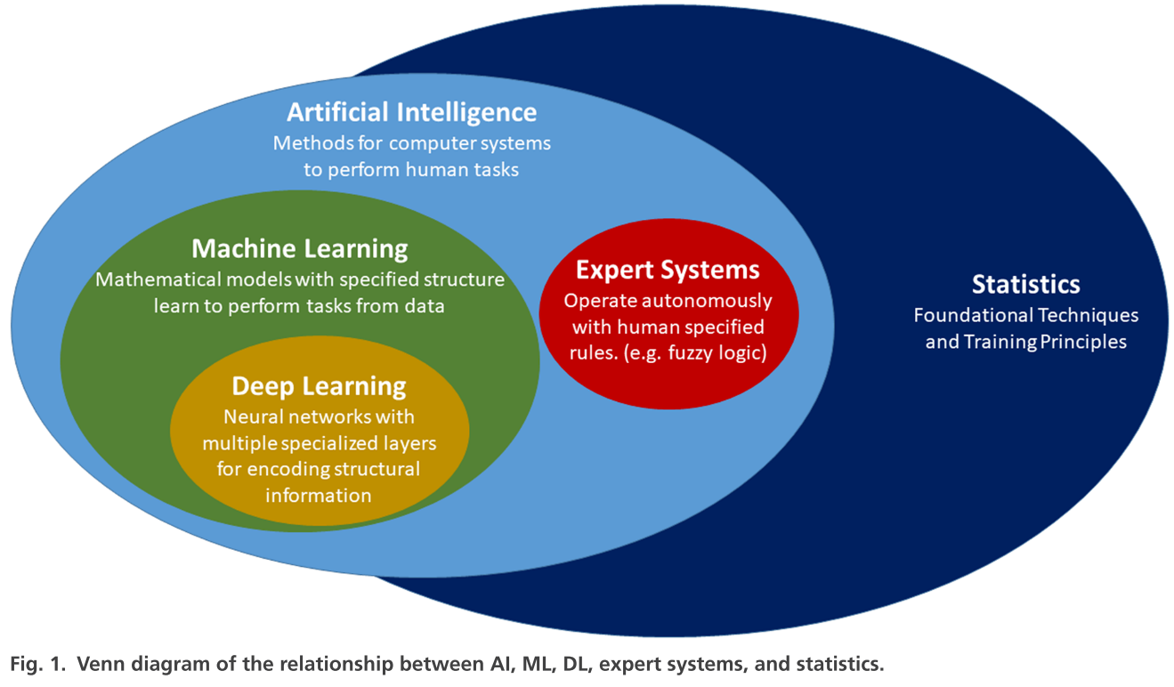
Convolutional Neural Networks

Slide 3
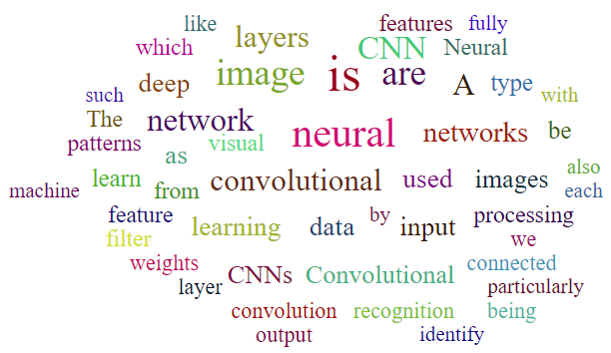
What is a Convolutional Neural Network
Notes:
I usually like to start talks like this with a definition, but the definitions I found online were so long winded and I felt never got to the true point. So I made a word cloud based on a handful of those definitions. Obviously we see the words convolution, convolutional, neural, and network.
The words picked out that hits the point of a convolutional neural network are image, images, patterns, features, learning, recognition, and such.

Slide 4
Really, what is it?
Convolutional Neural Networks are…
A supervised learning algorithm → Trains on labeled datasets to classify or predict
A deep learning neural network → A neural network with more than a few layers with the functionality to learn its own parameters/weights
For computer vision → Artificial intelligence algorithm which allows a computer to interpret images or visual data
Notes:
The category of convolutional neural networks do the best job to describe what it is, in my opinion. It’s a supervised learning algorithm, meaning it uses labeled datasets to train itself for classification or prediction problems. It is a deep learning neural network, meaning it has more than a few layers in the algorithm and learns its own parameters based on the training dataset. And they are for computer vision, aka its an algorithm created to allow a computer to interpret images or visual data since computers cant really ‘see’ things.

Slide 5
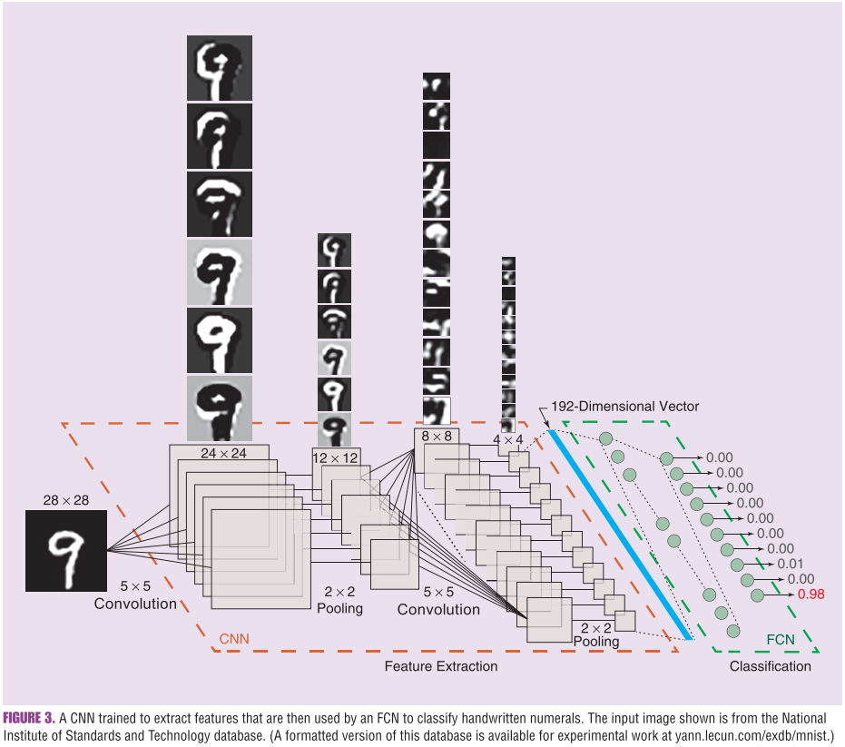
Handwriting Classification Example
Convolutional Layer
Pooling Layer
Convolutional Layer
Pooling Layer
Flattening
Fully Connected Neural Network of Dense Layers
Input Image
Output for Classification

Slide 6


Extracting Image Features
Convolutional Layer
Pooling Layers
Alters an image with a small learned filter (also known as a kernel), that highlights different patterns, edges, or values
Reduces the resolution of an image by taking the mean or maximum values from a passing window
Reduces processing power needed and forces the convolutional layers to evaluate consecutively larger areas
https://paperswithcode.com/method/max-pooling
https://en.m.wikipedia.org/wiki/File:2D_Convolution_Animation.gif

Slide 7
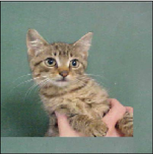
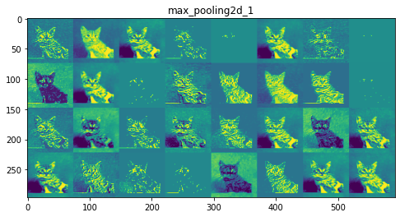
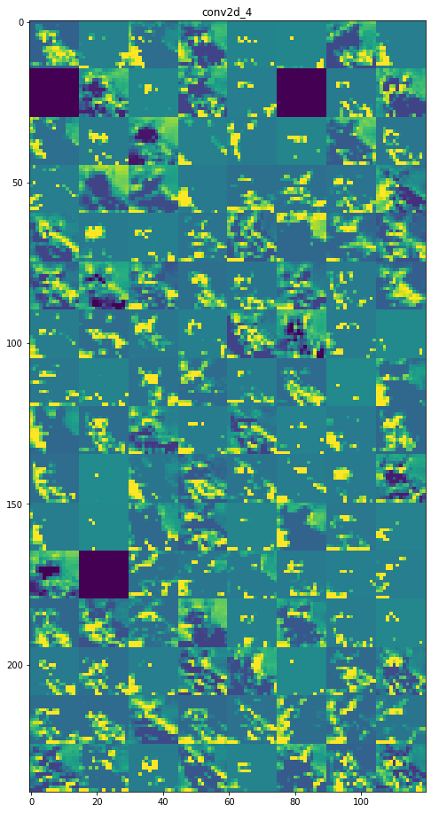
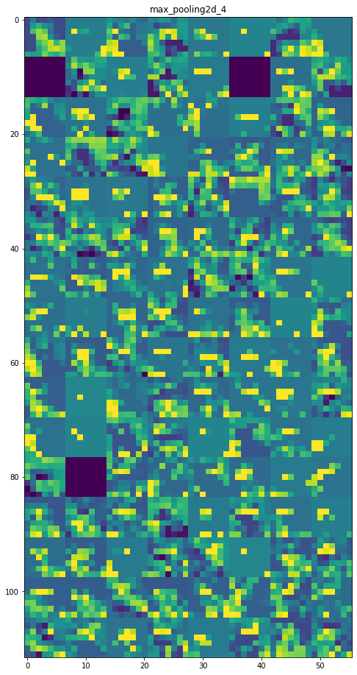
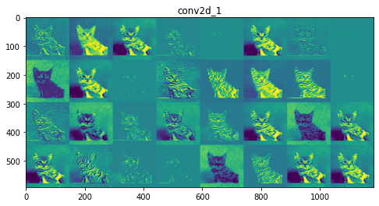
Extracting Image Features
Example:
Max-Pooling Output
Convolutional Output
Max-Pooling Output
Convolutional Output
Process is repeated 3 times
Notes:
https://www.geeksforgeeks.org/visualizing-representations-of-outputs-activations-of-each-cnn-layer/
The number of filter increases at each layer
The subsequent filters identify larger and larger patterns within the image

Slide 8
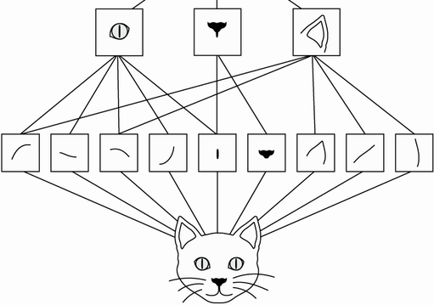
Extracting Image Features
Cat image is our Sample or Input
Example:
Max-Pooling Output
Convolutional Output
Max-Pooling Output
Convolutional Output
Process is repeated 3 times
Each new image is called a Feature Map
Notes:
https://www.geeksforgeeks.org/visualizing-representations-of-outputs-activations-of-each-cnn-layer/
The number of filter increases at each layer
The subsequent filters identify larger and larger patterns within the image
They can learn spatial hierarchies of patterns. A first convolution layer will learn small local patterns such as edges, a second convolution layer will learn larger patterns made of the features of the first layers, and so on (see figure 8.2). This allows convnets to efficiently learn increasingly complex and abstract visual concepts, because the visual world is fundamentally spatially hierarchical. (Chollet)

Slide 9
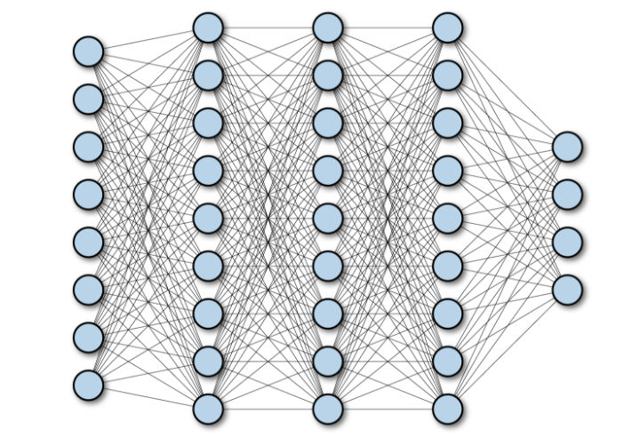

Flattening
Feature Maps Flattened Into One Array
Max-Pooling Output
Fully Connected Neural Network
Output
(Classification or Regression)
$$⋮$$

Slide 10
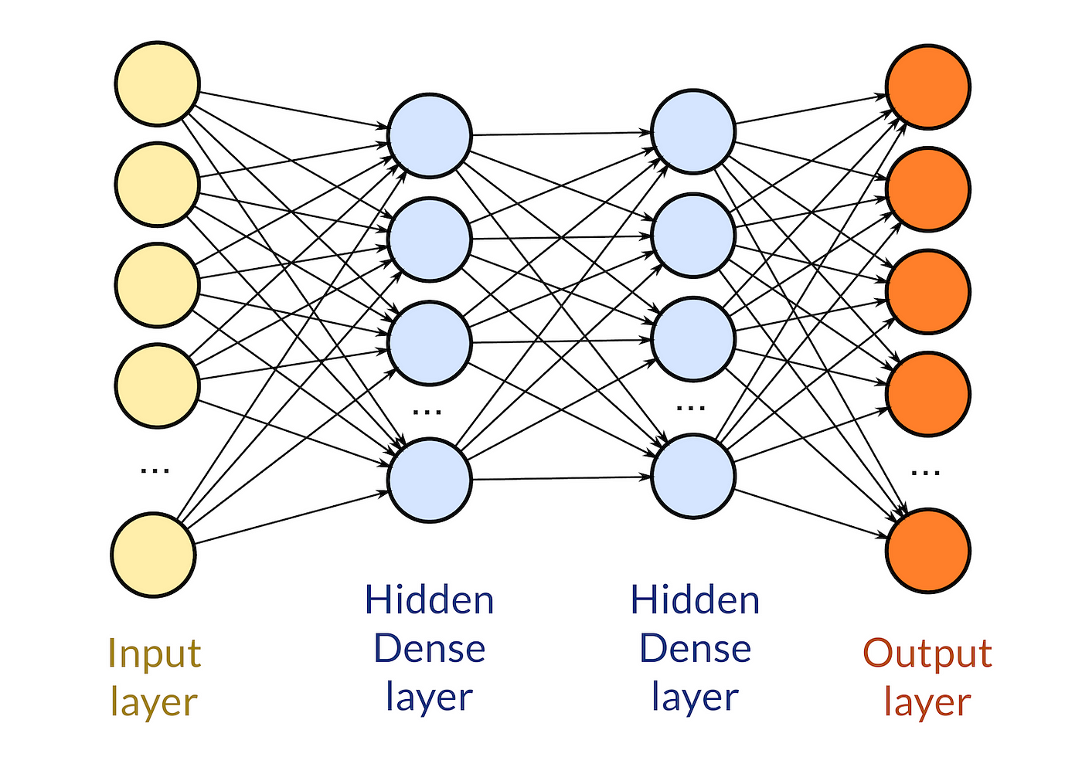
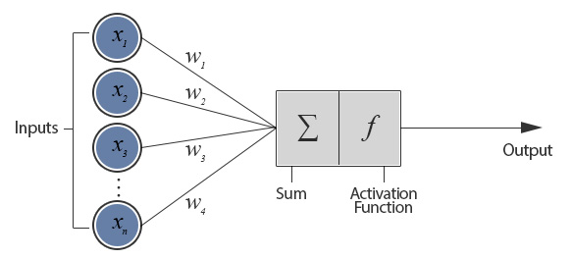
Fully Connected Neural Network
Perceptrons
Dense Layers
Input data is multiplied by learned weights, aggregated, then passed through an activation function
Layers of perceptrons which transfer information from layer to layer, to the output value(s)
https://sites.cc.gatech.edu/~san37/post/dlhc-fnn/
https://medium.datadriveninvestor.com/custom-layers-in-keras-de5f793217aa

Slide 11
Handwriting Classification Example
Convolutional Layer
Pooling Layer
Convolutional Layer
Pooling Layer
Flattening
Fully Connected Neural Network of Dense Layers
Input Image
Output for Classification

Slide 12
Batch Normalization
In training, the training subset is sent in batches that may not be evenly representative
Batch normalization is then used to help smooth and quicken training
It will normalize the data even as the mean and variance change over time during training
During training it uses the mean and variance of the current batch of data to normalize the samples
It uses an exponential moving average of the batch-wise mean and variance of the data seen during training

Slide 13
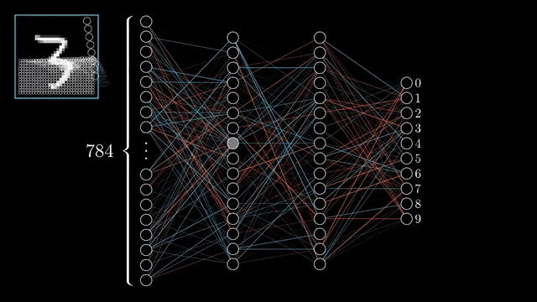
How does the Model Learn? Formulating Error
Prediction error or loss – The measurement of the distance between your model’s prediction and the target
Minimizing the loss function is how the algorithm “learns”
Common Loss Metrics:
Binary | Categorical | Numerical
Binary Cross Entropy | Categorical Cross Entropy | Mean Squared Error Mean Absolute Error

Slide 14
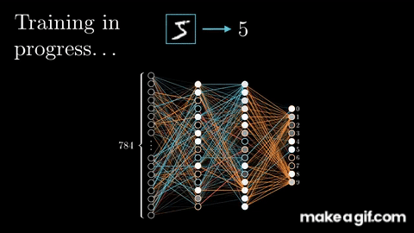
How does the Model Learn? Backpropagation
Backpropagation – updates the weights within the model to minimize the loss using the gradient

Slide 15
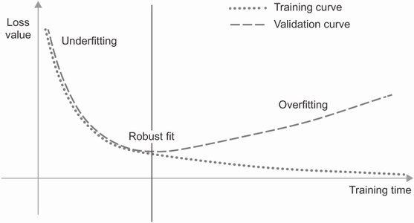
Overfitting to the Training Subset
Optimization – Adjusting the model for the best performance
Generalization – How well the trained model performs on data it has never seen
Overfitting – Learning representations only specific to the training data and do not generalize to the validation data

Slide 16
Overfitting to the Training Subset
Optimization – Adjusting the model for the best performance
Generalization – How well the trained model performs on data it has never seen
Overfitting – Learning representations only specific to the training data and do not generalize to the validation data
Challenges:
Noisy training data
Ambiguous features
Rare features
Spurious correlations (correlation is not causation)

Slide 17
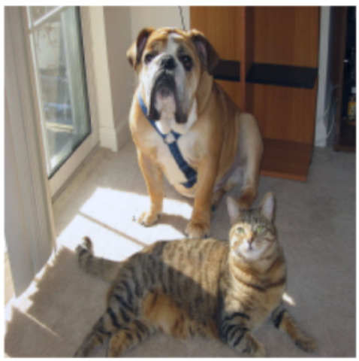
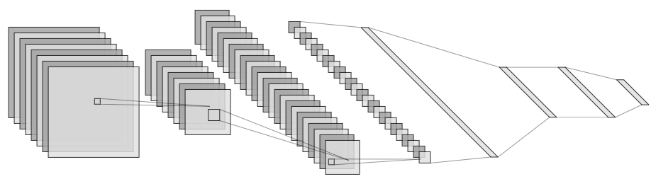
Grad-CAM (Gradient-weighted Class Activation Maps)
What is in this image?
An Explainable AI technique to create ‘visual explanations’ for the decisions within a CNN
Formulate heatmap from the weighted summation of gradients from an output node to all the feature maps of the last convolutional layer
In short, Grad-CAMs highlight the grid points where the CNN is ‘looking’ during prediction
Animal Detector CNN
Where in the image is the CNN looking to identify the Dog and Cat?
96% Dog
92% Cat

Slide 18
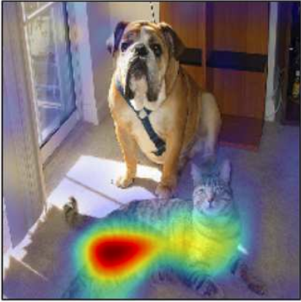
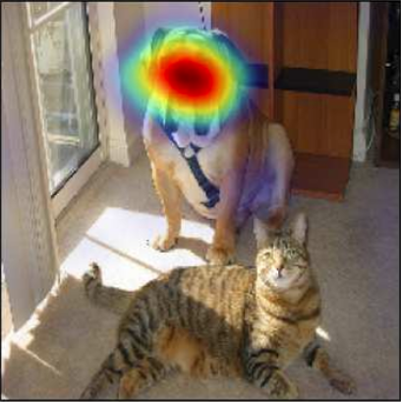
Grad-CAM (Gradient-weighted Class Activation Maps)
What is in this image?
Animal Detector CNN
Where in the image is the CNN looking to identify the Dog and Cat?
96% Dog
92% Cat
Grad-CAM:
Weighted summation of the gradients from an output node to all feature maps
Strong Gradients = High Importance
Grad-CAM for ‘Cat’
Grad-CAM for ‘Dog’

Slide 19
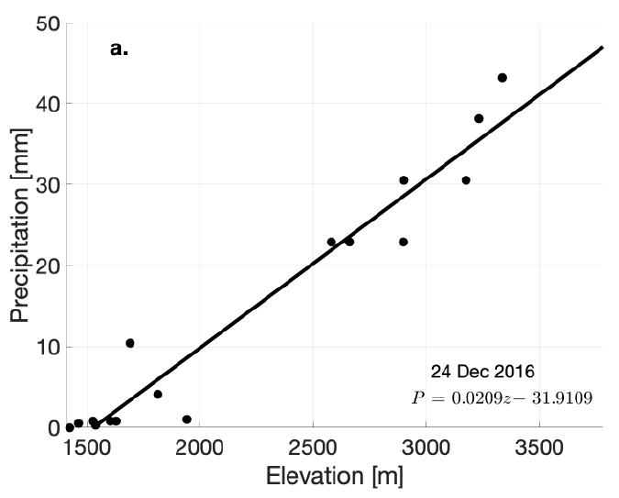
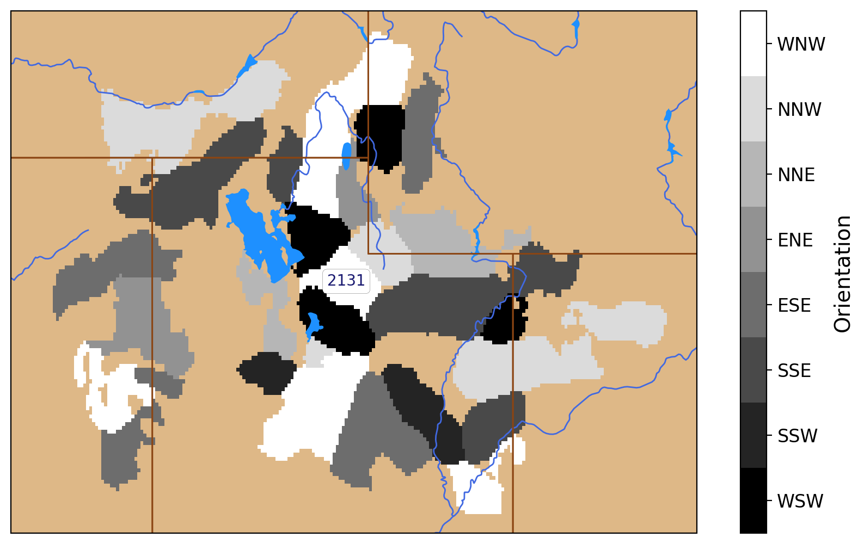
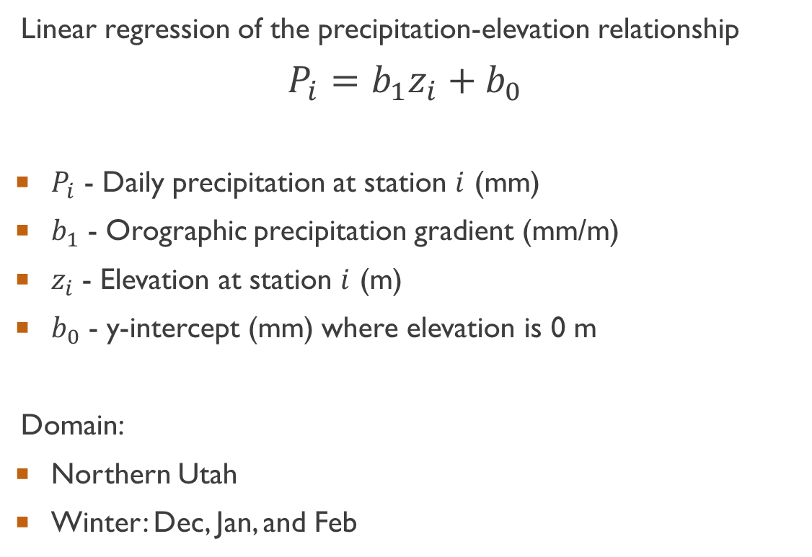
Orographic Precipitation Gradients (OPG)
Linear regression of the precipitation-elevation relationship
$$P_{i}=b_{1}z_{i}+b_{0}$$
$P_{i}$ - Daily precipitation at station $i$ (mm)
$b_{1}$ - Orographic precipitation gradient (mm/m)
$z_{i}$ - Elevation at station $i$ (m)
$b_{0}$ - y-intercept (mm) where elevation is 0 m
Domain:
Northern Utah
Winter: Dec, Jan, and Feb
Fig. Precipitation-elevation regression
Fig. Northern Utah Facets

Slide 20
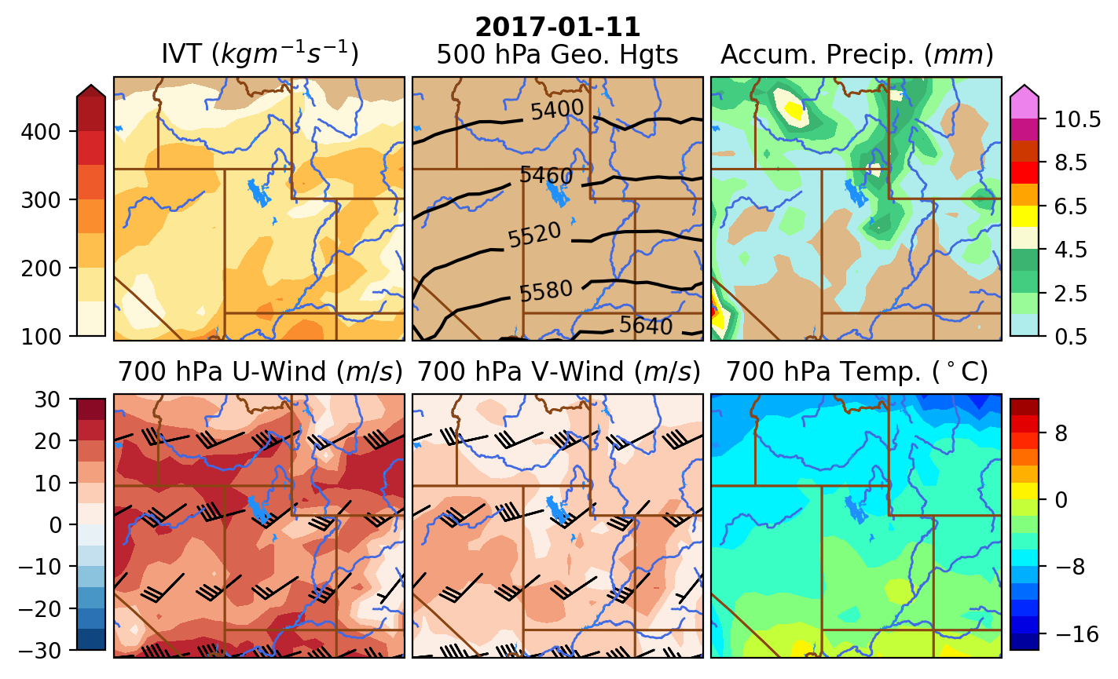
Predictor Dataset
ECMWF ERA5 at 0.5° Grid-Spacing
Variables | Levels (“Images”)
Integrated Vapor Transport | Formulated from Specific Humidity, U-Winds, and V-Winds
U-Winds | 700 hPa
V-Winds | 700 hPa
Geopotential Height | 500 hPa
Accumulated Precipitation | Surface
Temperature | 700 hPa
Fig. CNN input domain and variables
Notes:
Why this size of domain?
Looking more for the widespread variability of OPG which is dependent on the synoptic setup, the CNN itself should pick up on the differences between facets
Small scale forecast models are not as good, ie, resolutions of terrain, and larger differences between models

Slide 21
References
Bohne, L., C. Strong, and W. J. Steenburgh, 2020: Climatology of orographic precipitation gradients in the contiguous western United States. J. Hydrometeor., 21, 1723–1740.
Chase, R. J., D. R. Harrison, G. M. Lackmann, and A. McGovern, 2023: A Machine Learning Tutorial for Operational Meteorology. Part II: Neural Networks and Deep Learning. Wea. Forecasting, 38, 1271–1293, https://doi.org/10.1175/WAF-D-22-0187.1.
Chollet, F., and Coauthors, 2015: Keras. https://keras.io.
Chollet, F., 2021: Deep Learning with Python. Manning Publications Co., 478 pp.
Gonzalez, R. C., 2020: Deep Convolutional Neural Networks [Lecture Notes]. IEEE Signal Processing Magazine, 35(6), 79-87, https://doi.org/10.1109/MSP.2018.2842646.
Haupt, S. E., and Coauthors, 2022: The History and Practice of AI in the Environmental Sciences. Bull. Amer. Meteor. Soc., 103, E1351– E1370, https://doi.org/10.1175/BAMS-D-20-0234.1.
Hersbach, H., and Coauthors, 2023a: ERA5 hourly data on pressure levels from 1940 to present. Copernicus Climate Change Service (C3S) Climate Data Store (CDS), accessed 18 January 2023, doi: 10.24381/cds.bd0915c6.476
Hersbach, H., and Coauthors, 2023b: ERA5 hourly data on single levels from 1940 to present. Copernicus Climate Change Service (C3S) Climate Data Store (CDS), accessed 28 January 2023, doi: 10.24381/cds.adbb2d47.
Ioffe, S., and C. Szegedy, 2015: Batch normalization: Accelerating deep network training by reducing internal covariate shift. Proc. 32nd Int. Conf. on Machine Learning, https://doi.org/10.48550/arXiv.1502.03167.
Selvaraju, R. R., M. Cogswell, A. Das, R. Vedantam, D. Parikh, and D. Batra, 2020: Grad-cam: Visual explanations from deep networks via gradient- based localization. Int. J. of Comput. Vis., 128, 336-359, https://doi.org/10.1007/s11263-019-01228-7.

